Slide 1
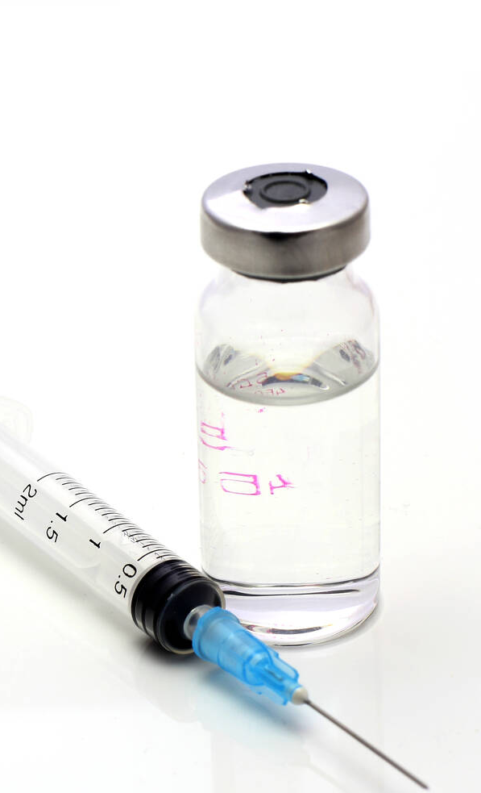
Advisory Commission on Childhood Vaccines (ACCV) Food and Drug Administration Update June 18, 2021 CDR Valerie Marshall, MPH, PMP, GWCPM Immediate Office of the Director Office of Vaccines Research and Review (OVRR) Center for Biologics Evaluation and Research (CBER) Food and Drug Administration (FDA)

Slide 2
COVID-19 VACCINE - Janssen
On February 27, 2021, the Food and Drug Administration (FDA) issued an emergency use authorization (EUA) for a third vaccine for the prevention of coronavirus disease 2019 (COVID-19) caused by severe acute respiratory syndrome coronavirus 2 (SARS-CoV-2).
The EUA allows the Janssen COVID-19 Vaccine to be distributed in the U.S. for use in individuals 18 years of age and older.

Slide 3
Expansion of age indication for Pfizer’s covid-19 vaccine
On May 10, 2021, the FDA expanded the EUA for the Pfizer-BioNTech COVID-19 Vaccine to include 12 – 15-year-old adolescents.

Slide 4
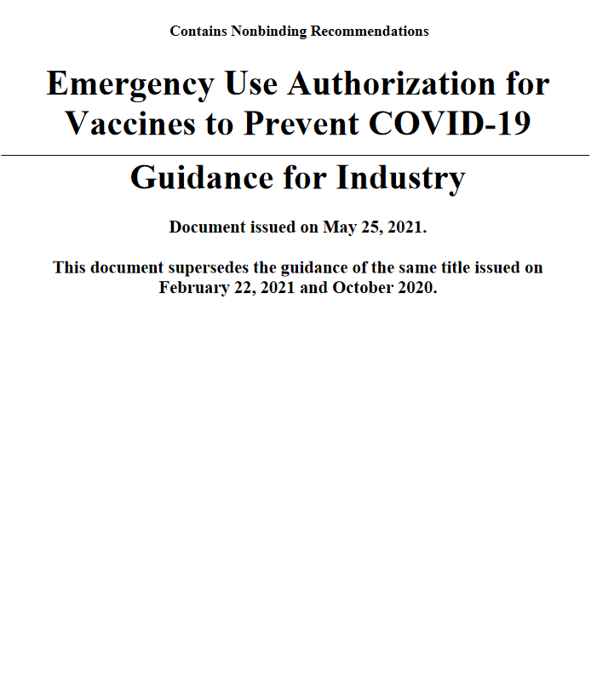
updated fda guidance- COVID-19 vaccines
On May 25, 2021, the FDA updated its guidance entitled, “Emergency Use Authorization for Vaccines to Prevent COVID-19”
The update clarifies how the agency intends to prioritize review of EUA requests for the remainder of the COVID-19 public health emergency.

Slide 5
Vaccines and Related Biological Products Advisory Committee
On June 10, 2021, the Vaccines and Related Biological Products Advisory Committee met in open session to discuss, in general, data needed to support authorization and/or licensure of COVID-19 vaccines for use in pediatric populations.

Slide 6
New vaccine approval - Prevnar 20™
On June 8, 2021, CBER/OVRR approved Prevnar 20™, pneumococcal 20-valent conjugate vaccine indicated for active immunization for the prevention of pneumonia and invasive disease caused by Streptococcus pneumoniae serotypes 1, 3, 4, 5, 6A, 6B, 7F, 8, 9V, 10A, 11A, 12F, 14, 15B, 18C, 19A, 19F, 22F, 23F and 33F in adults 18 years of age and older.
The vaccine is administered as a single intramuscular dose.
The vaccine is manufactured by Wyeth Pharmaceutical LLC, a subsidiary of Pfizer, Inc.

Slide 7
UPDATED SAFETY LABELING - SHINGRIX
In March 2021, FDA approved a supplement to the Biologics License Application (BLA) for Zoster Vaccine Recombinant, Adjuvanted (SHINGRIX)
To update the “Warnings and Precautions” and “Adverse Reactions” sections of the Package Insert labeling to include new safety information on the risk of Guillain-Barré Syndrome (GBS) following vaccination with SHINGRIX.

Slide 8
FLUCELVAX - QUADRIVALENT
In March 2021, the FDA approved a supplement to the BLA for Flucelvax Quadrivalent to extend the age indication to persons 2 years of age and older.

Slide 9
Thank you

