Slide 1
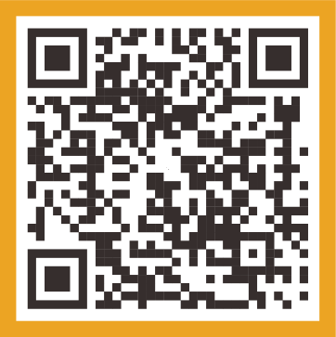
The Newborn Screening Information Center (NBSIC)
November 2024
Scan the QR code to visit the Newborn Screening Information
Center website.
newbornscreening.hrsa.gov

Slide 2
Meet the RTI Team
Communication Science/Human-Centered Design
Digital and Content Strategy
NBS/Genetics Expertise
Molly Lynch, MPH
Jenna Reno, PhD
Casey Horvitz, MPH
Nicole Mullen
Melissa Raspa, PhD
Becca Wright, MPH, RD
Ana Forsythe, MS, GC
Amy Gaviglio, MS, CGC
Doug Rupert, MPH
Joe Milazzo
Christel Gianci
Jason Arrol
Lauren Reynolds
Ivonne Headley, MPH, RDN

Slide 3
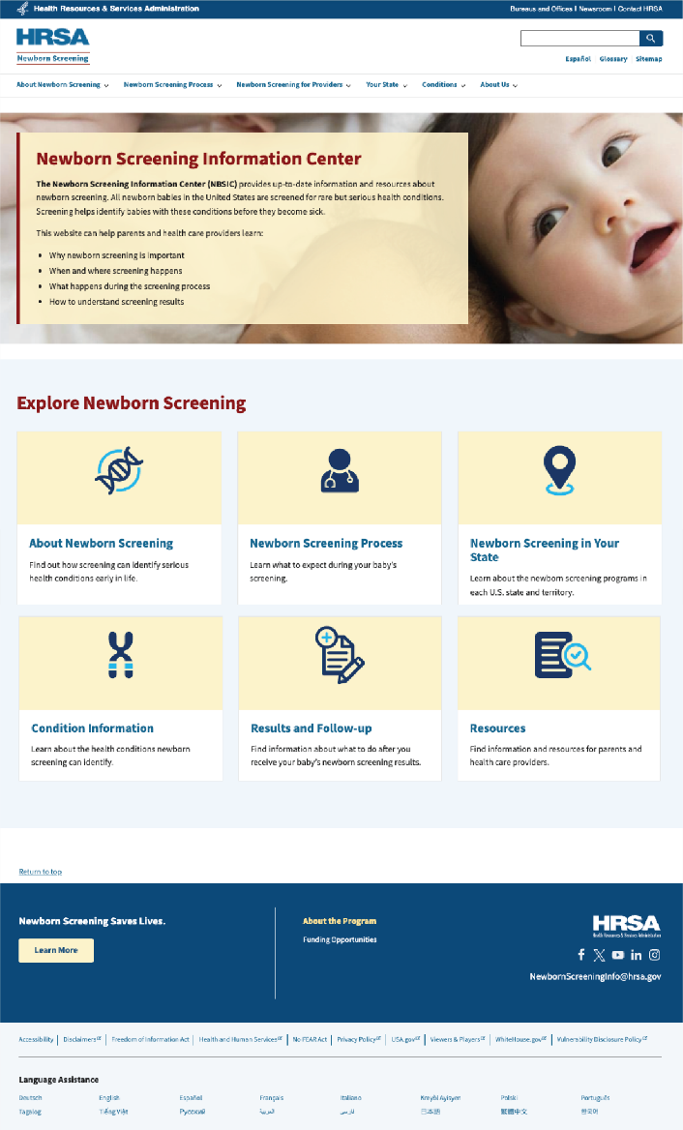
The Newborn Screening Information Center (NBSIC)
Launched in 2020 as part of legislation from the NBS Saves Lives Reauthorization Act
Over 300,000 users visited the site last year
Goal of the NBSIC: Increase awareness, knowledge, and understanding of newborn screening (NBS) among expectant parents and other users.

Slide 4
Explore the Site: newbornscreening.hrsa.gov

Slide 5
Our Goals:
1 |  | Engage with state/territory NBS programs to keep the site up-to date with accurate information.
2 |  | Conduct expert review of condition pages and add new condition pages, as needed.
3 |  | Use insights from website audiences to develop new content and website enhancements.
4 |  | Promote the site to parents, health care providers, and other key audiences.

Slide 6
Current and Future Site Enhancements

Slide 7
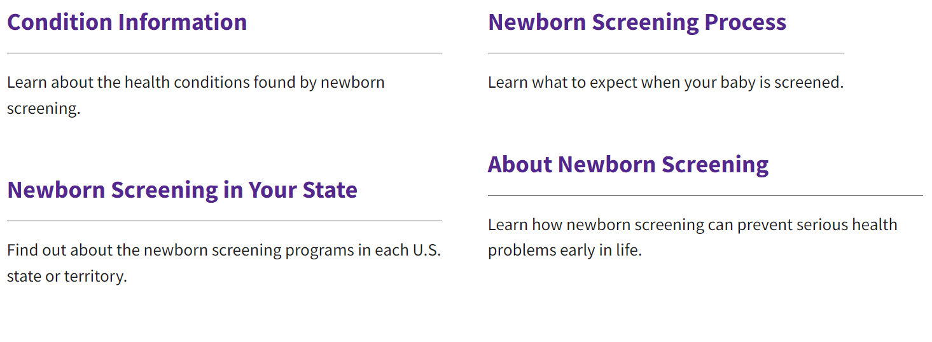
Redesigned Homepage
Redesigned homepage navigation to help website users more easily find what they need.

Slide 8
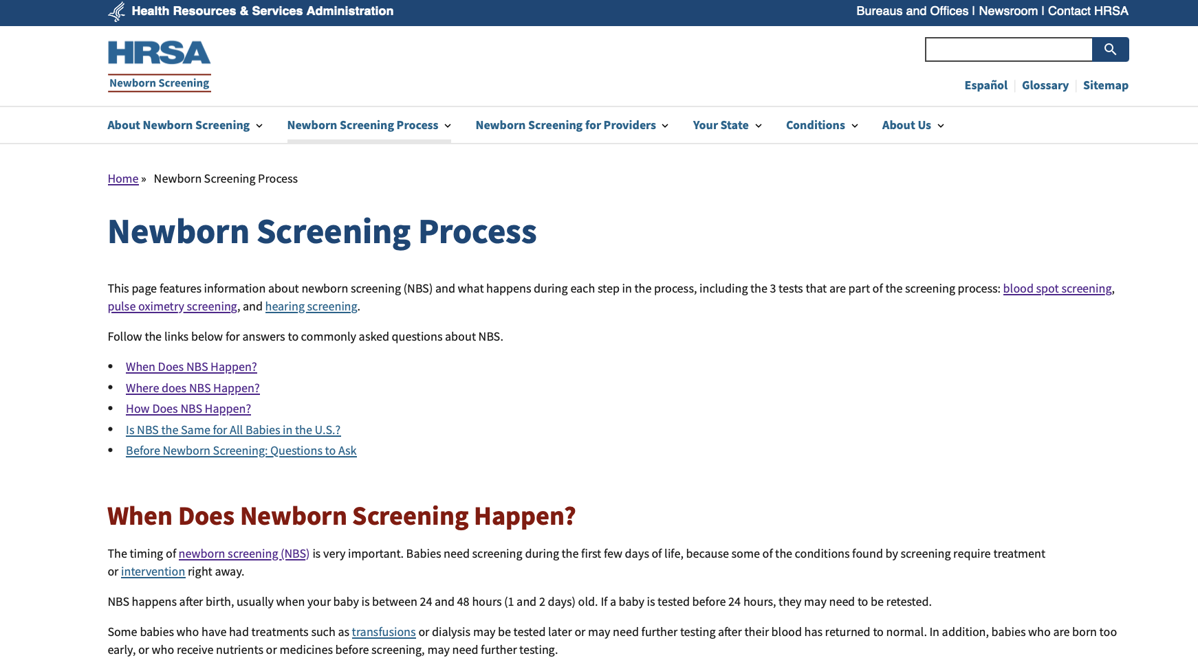
Highlighted Main Messages on Key Pages
Developed main messages to highlight what the website user is expected to learn or do on the page.

Slide 9
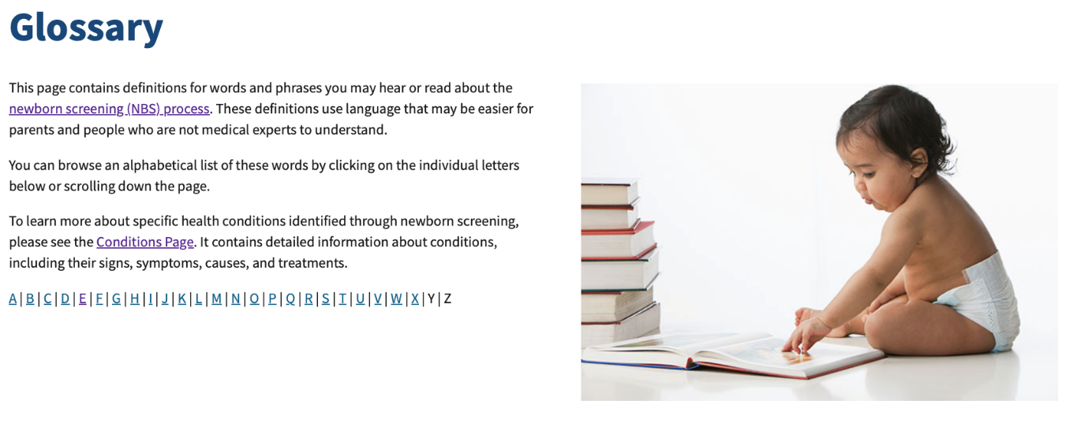
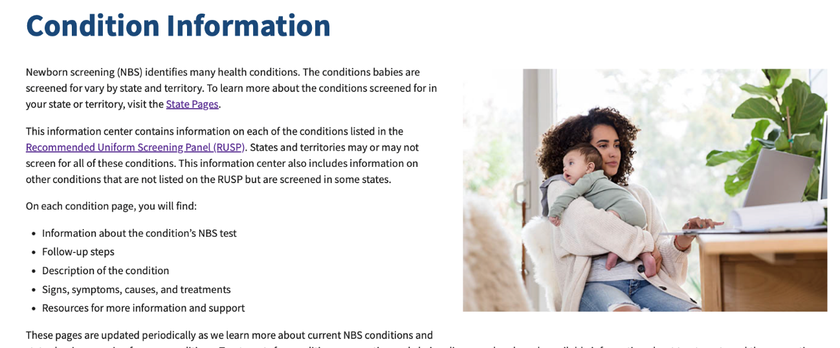
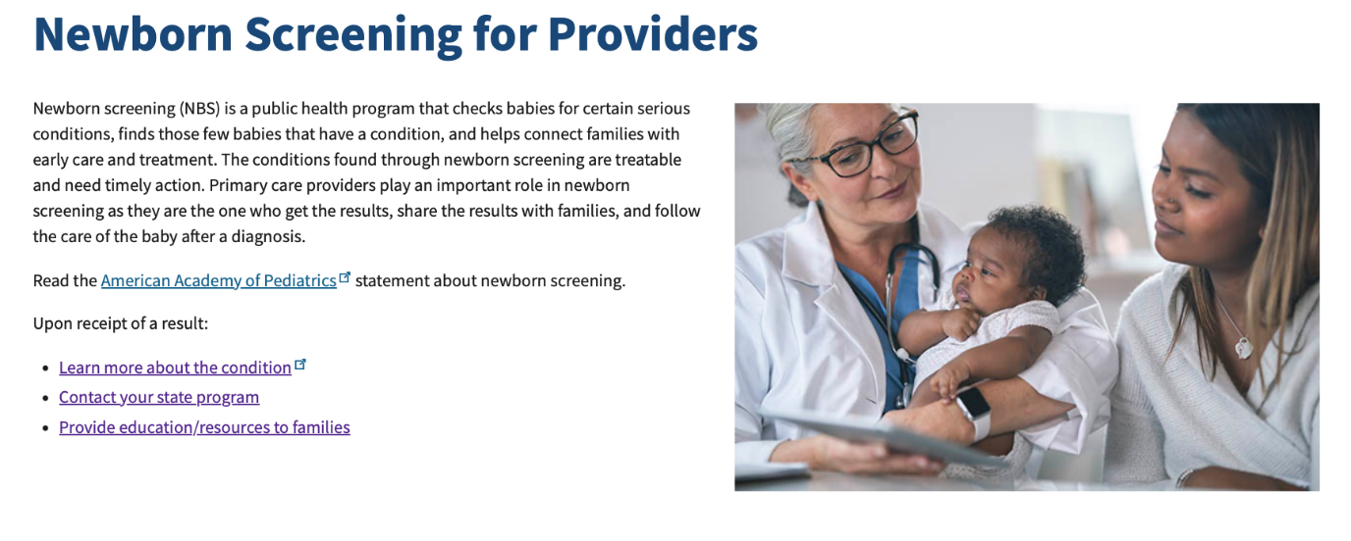
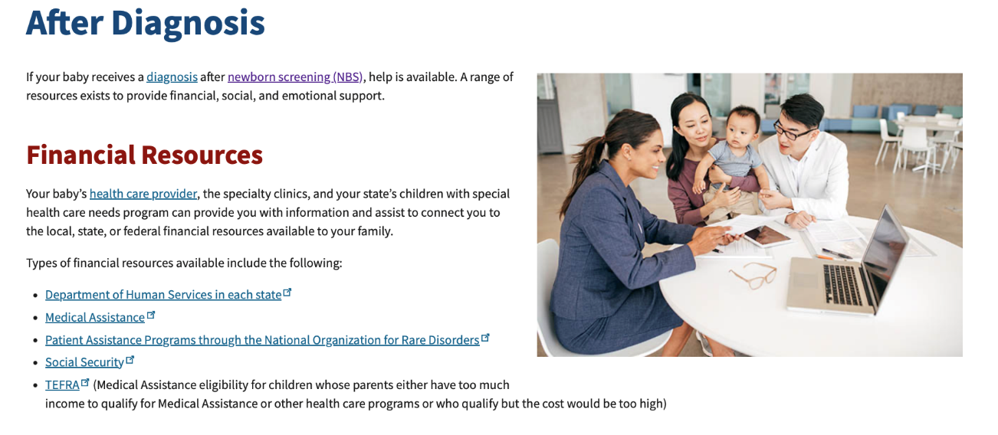
Visual Enhancements
Added photographs to increase engagement on the site.

Slide 10
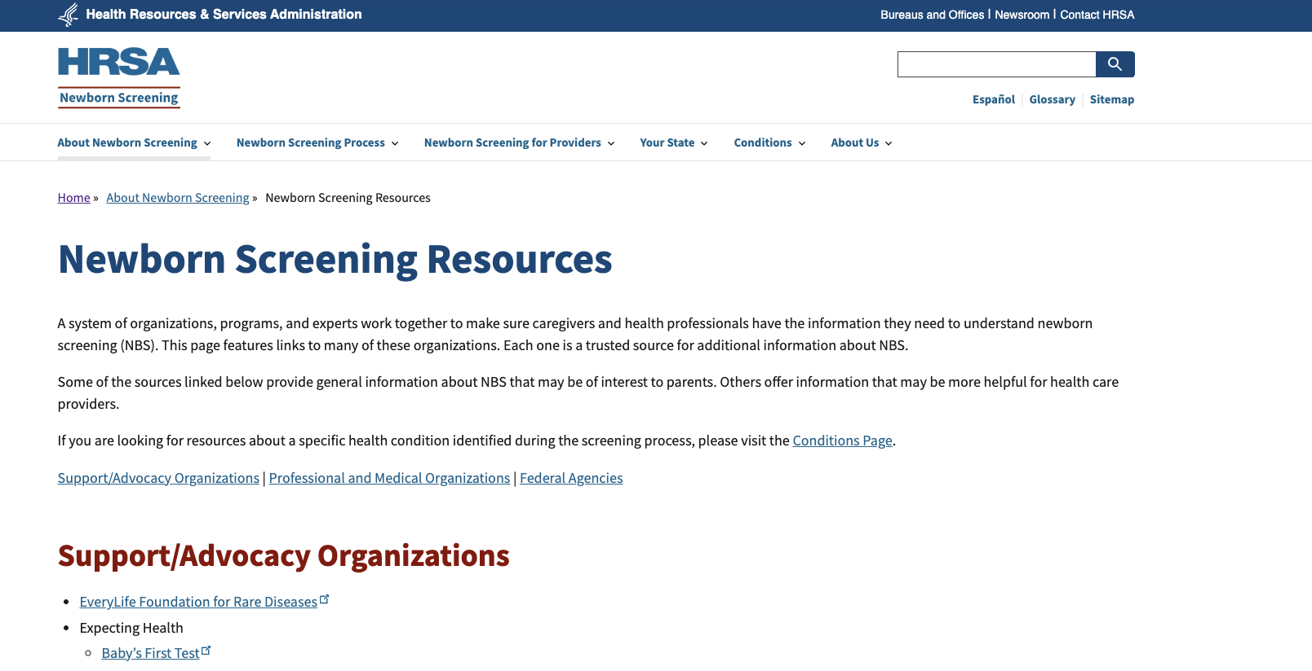
Reorganized Resources Page
Added a main message and reordered content to be more parent-centric.

Slide 11
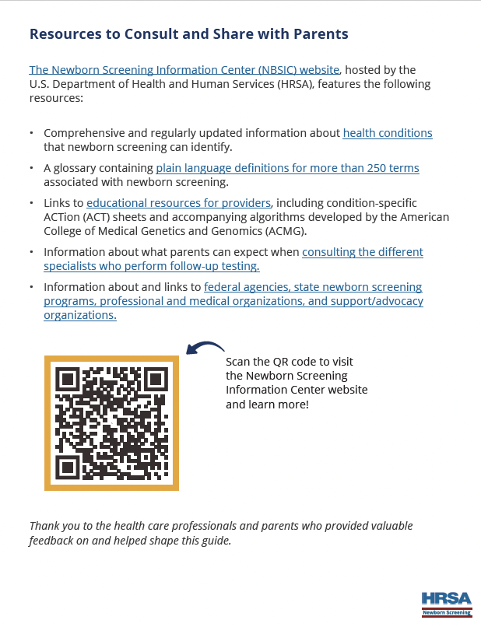
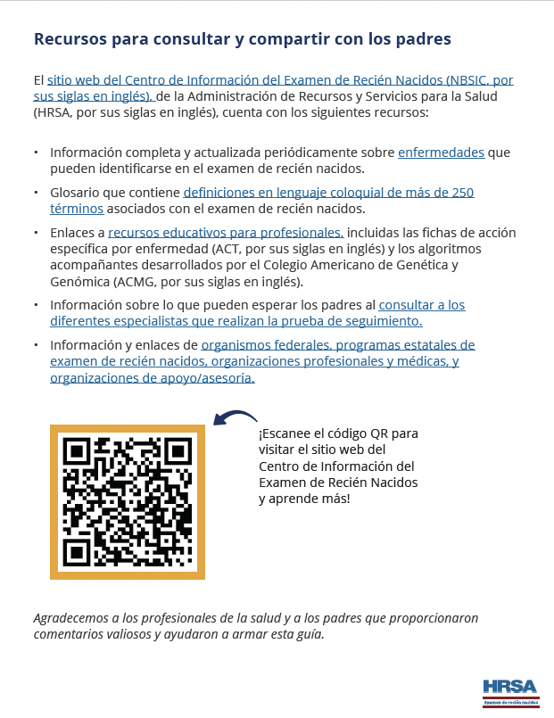
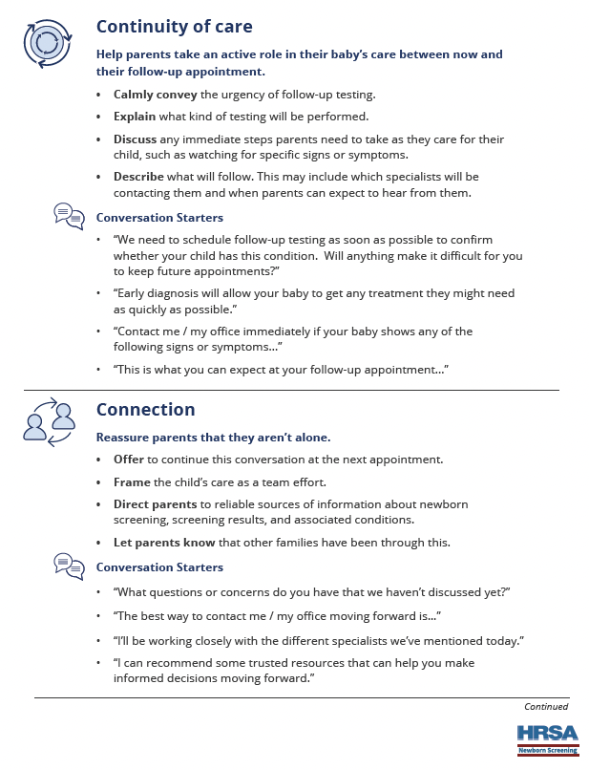
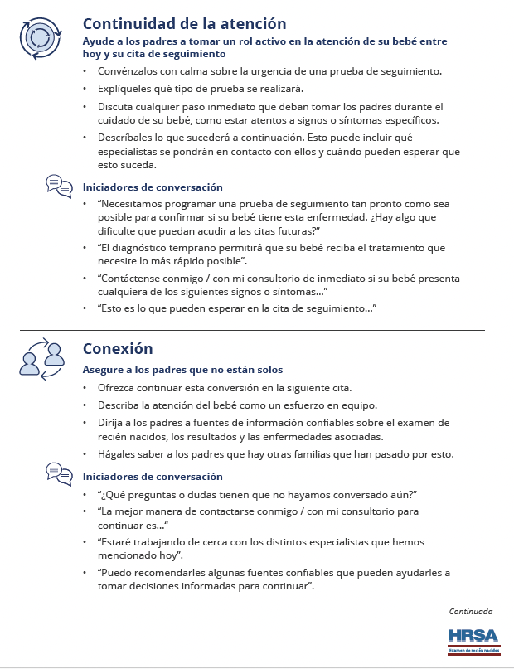
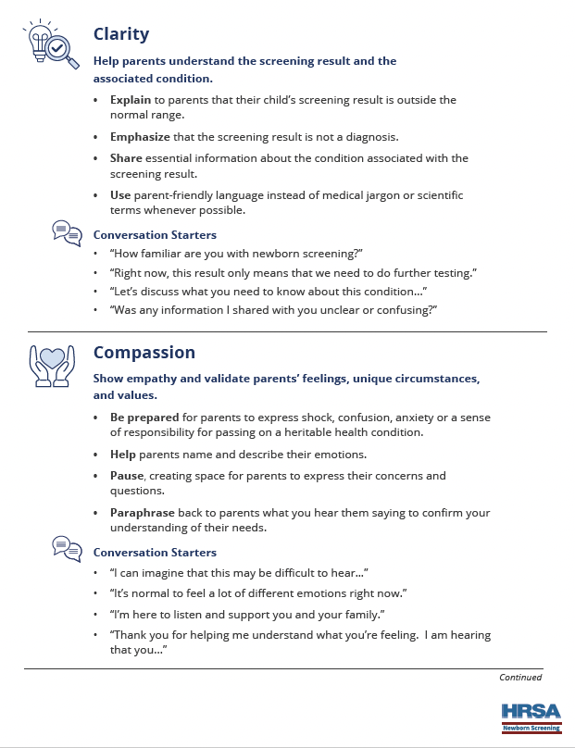
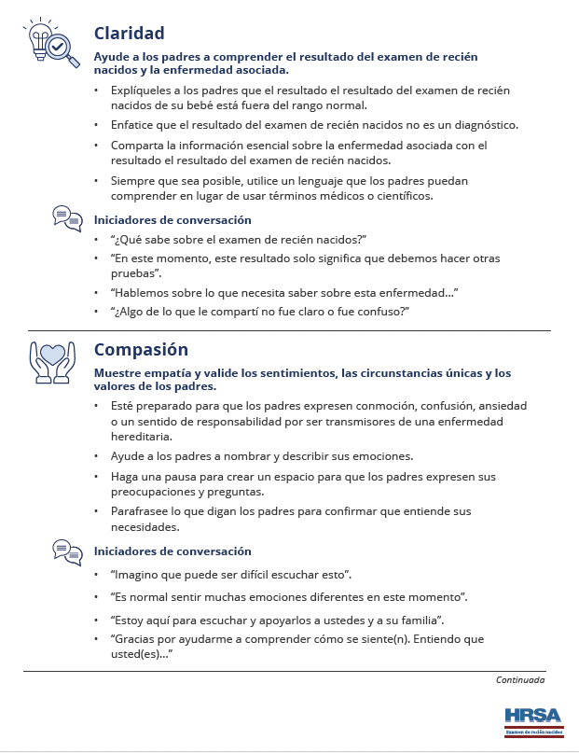
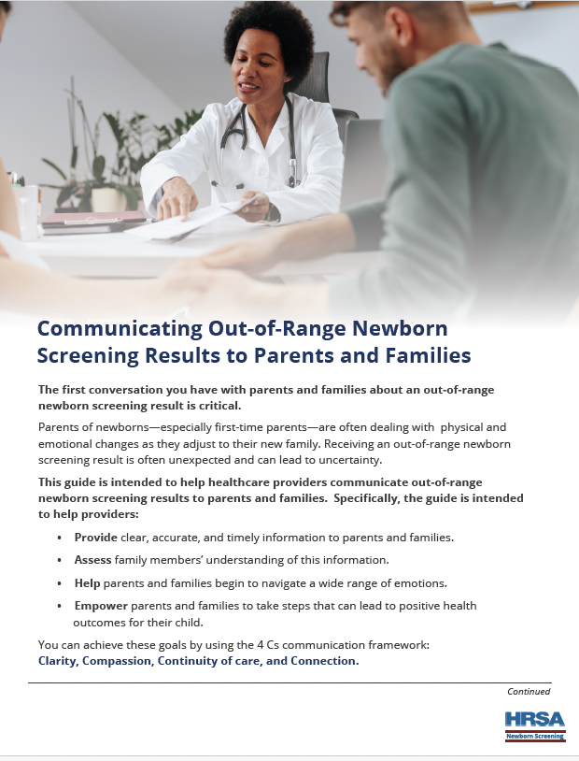
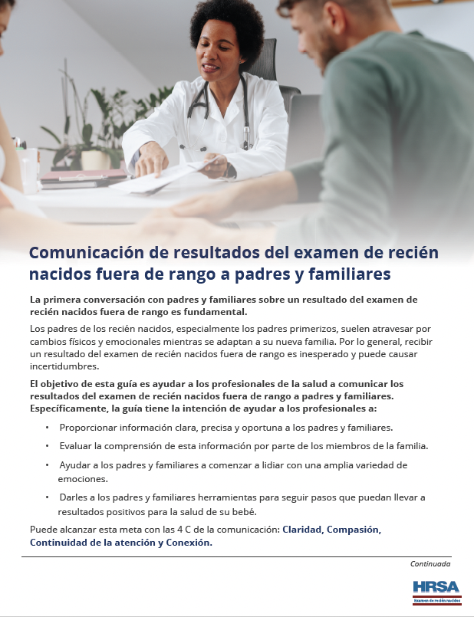
New Resource: Out-of-Range Communication Guide for Providers
English Language Version
Spanish Language Version

Slide 12
Future Enhancements (English and Spanish)
Road to the
RUSP
Parent-friendly NBS Resources
Enhanced Provider Page
Updated content and graphics to describe the process for adding conditions to the RUSP.
New webpages, infographics, and other content to describe the NBS process graphically and in plain language.
New resources and content specific to healthcare providers.

Slide 13
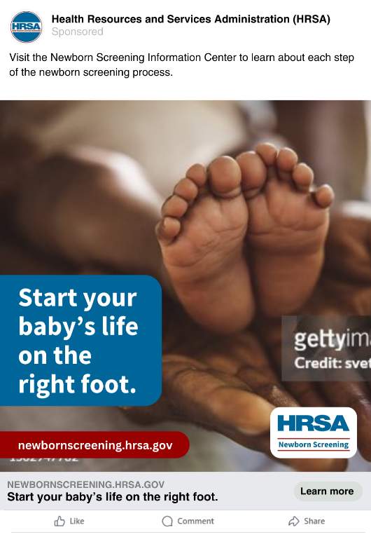
Promotion Activities
Submit abstracts and posters to at least 3 conferences
Presented at APHA, APHL, and ASHG
Create content partnerships (including links)
State NBS program websites
Professional and advocacy organization websites
Leverage paid media and observances
Continue running social media ads
Implement Google search ads
Launch larger social media campaign in September 2025 for NBS Awareness Month

Slide 14
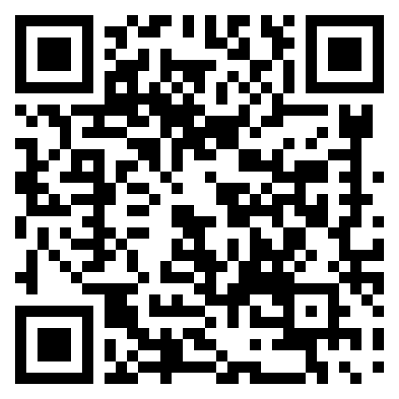
Visit the Newborn Screening Information Center
Visit the NBSIC to learn how newborn screening can identify babies with serious health conditions and ensure they receive the care and early treatment they need to live healthy lives.
Scan the QR code below to visit the NBSIC
newbornscreening.hrsa.gov

