Slide 1
Update on the National Vaccine Program to the
Advisory Commission on Childhood Vaccines (ACCV)
Sean Dade, MPA
Office of Infectious Disease and HIV/AIDS Policy (OIDP)
National Vaccine Program
Office of the Assistant Secretary for Health I U.S. Department of Health and Human Services
July 11, 2024

Slide 2
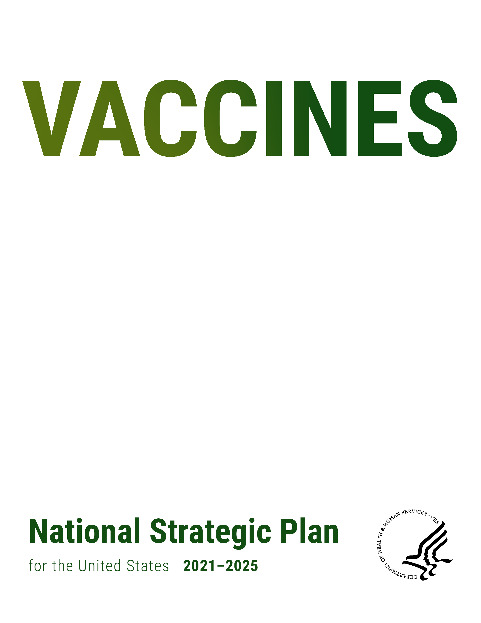
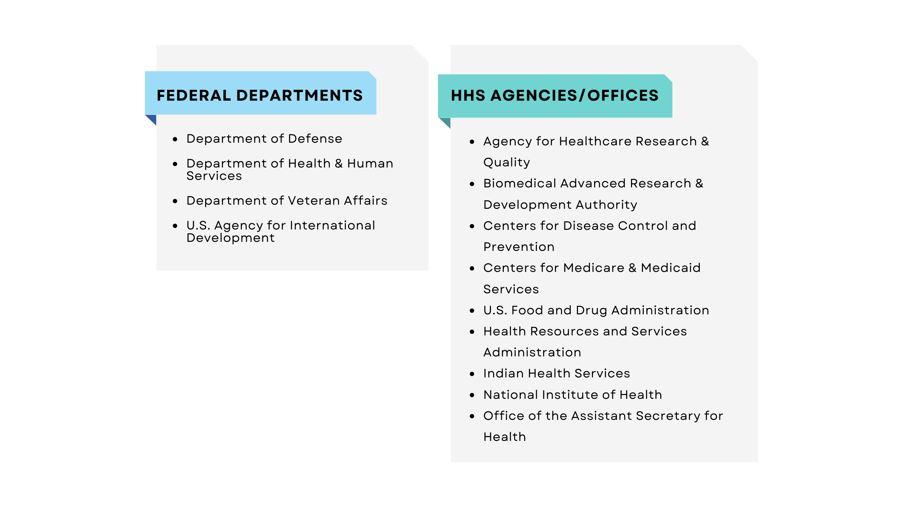
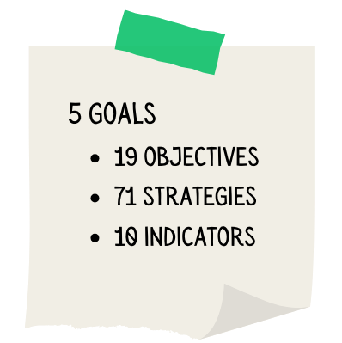
National Vaccines Strategic Plan 2021-2025

Slide 3


National Vaccine Program: Vaccine Plans and Reports
January 2021
May 2022
Federal
February 2023
Federal Implementation
National Strategic Plan
Implementation
Plan
Plan
Forthcoming
Vaccines Progress Report
2021-2023

Slide 4
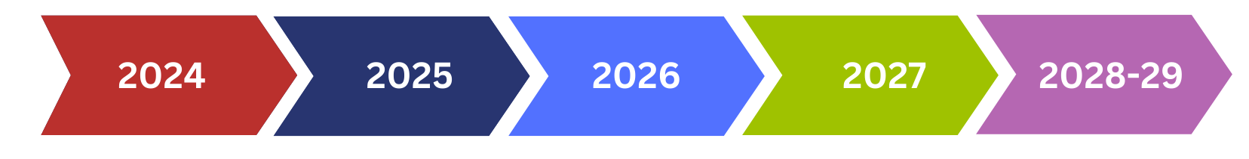
National Vaccine Strategic Plan 2026-2030 Timeline for Development Process
Plan & Gather Data
Engagements
NVAC Report
Draft plan
Clearances & Launch
Communications
Communications
Federal Implementation Plan
Evaluation & Progress
Course Correction(s) if needed
Look ahead

Slide 5
National Vaccine Advisory Committee (NVAC)
Last Meeting
    June 13-14, 2024
Day 1 Topics
    Rapid response: vaccine production capabilities
    Pride, equity, and mpox vaccination
    Breast cancer vaccine innovation
Day 2 Topics
    Immunization innovations
    Saluting global vaccinations
    Updated National Vaccine Strategy
Next Meeting
September 12-13, 2024; watch online at hhs.gov/live

Slide 6


Summer of PRIDE Mpox Equity Intervention
Collaborate with umbrella organizations for Black Prides and House/Ballroom Community to identify 20-30 events.
Connect local health departments and these events with the charge of developing syndemic-focused Sexual Health spaces that include mpox vaccine/education and related services.
USG role is coordination only.
Notes:
With these challenges in mind, HHS wanted to engage in a solutions-focused conversation with the community, focusing on addressing overarching challenges such as:
Community preferences
Available data for guidance
Lessons learned from previous mpox and other disease outbreaks
Following equity workshops with community-based organizations, three strong directives emerged:
Getting vaccines to Black Prides
Engaging with the House and Ballroom Community
Connecting with pageant communities

Slide 7
OIDP Vaccine Program: Priorities
Vaccine Equity
Addressing NVAC Equity Recommendations
Chairing equity workgroup for the National Adult and Influenza Immunization Summit (NAIIS)
VISION
Partner with federal and non-federal partners to prevent vaccine-preventable diseases through safe and effective vaccination over the lifespan
Vaccine Confidence
OIDP 3-year cooperative agreement
Vaccine Uptake
OIDP, CDC, and Immunize.org serve as co-sponsors to (NAIIS). 700 partners, 130 public and private organizations
Strategic Planning
Collaborating with partners to develop next iteration of National Vaccines Strategic Plan
NVAC Charge: recommendations for Vaccine Strategic Plan 2025-2030

Slide 8
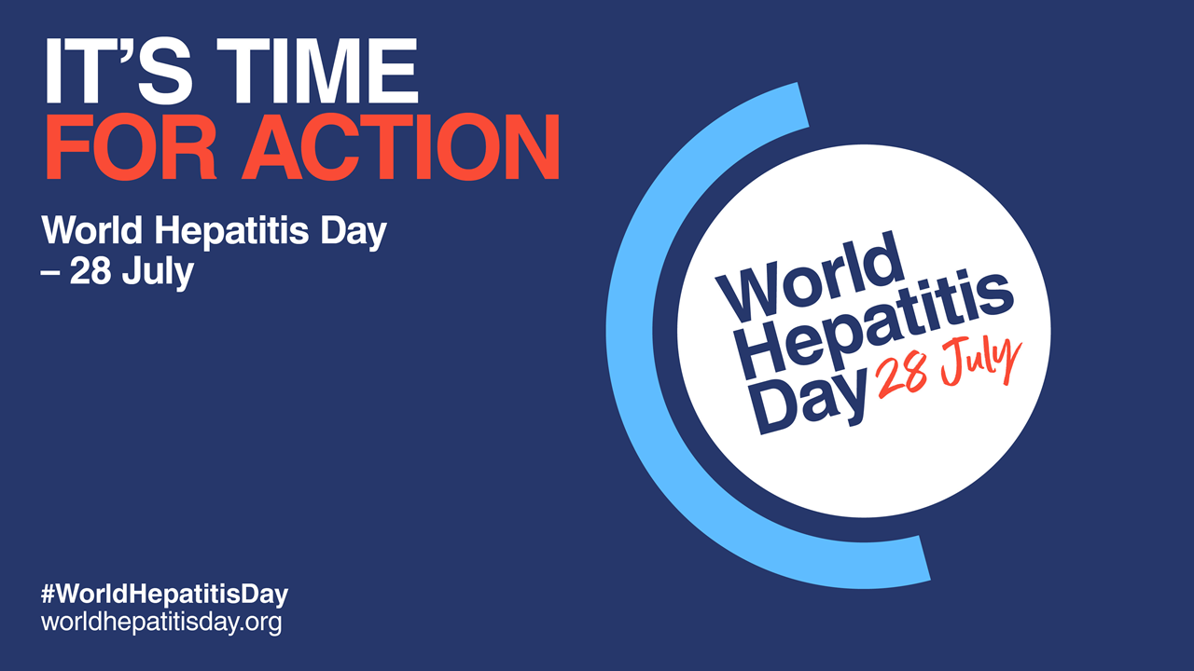
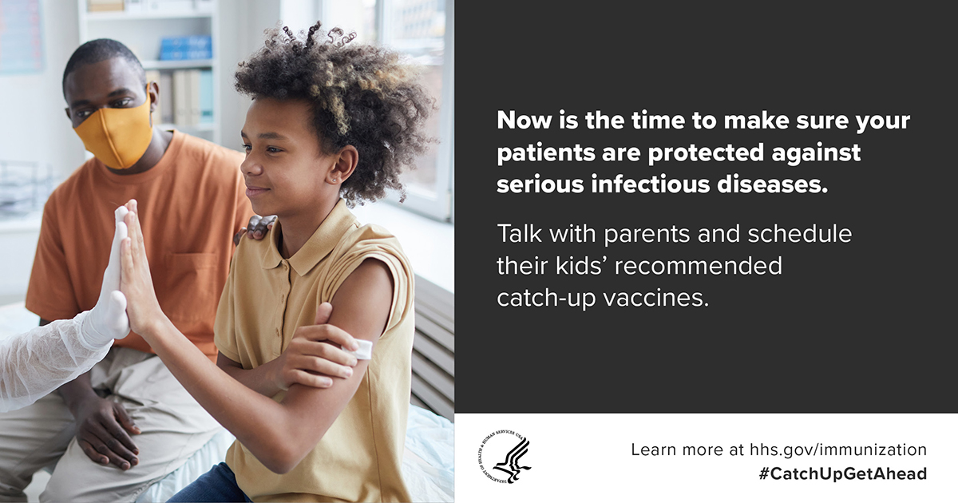

Communication and outreach activities across the Federal Government

Slide 9


Natl Vaccine Program
@HHSvaccines
hhs.gov/vaccines/index.html
Thank you!

