Slide 1

Centers for Disease Control and Prevention (CDC) Immunization Safety Office (ISO)
Update
Jonathan Duffy, MD, MPH
Immunization Safety Office
Centers for Disease Control and Prevention
Advisory Commission on Childhood Vaccines (ACCV) meeting
July 11, 2024

Slide 2
Recent CDC vaccine safety publications

Slide 3
Early Safety Findings Among Persons Aged ≥60 Years Who Received a Respiratory Syncytial Virus (RSV) Vaccine — United States, May 3, 2023–April 14, 2024
In May 2023, FDA licensed GSK (Arexvy) and Pfizer (Abrysvo) vaccines for prevention of RSV in adults aged 60 years and older.
During August 4, 2023–March 30, 2024, at least 10.6 million adults aged 60 years and older received a recommended RSV vaccine.
CDC reviewed reports made to the Vaccine Adverse Event Reporting System (VAERS) and V-safe to characterize early safety findings for both RSV vaccines among this population.
The safety profile is consistent with clinical trials, including the observance of a higher-than-expected number of verified cases of Guillain-Barré syndrome (GBS).
The estimated VAERS reporting rates of GBS after RSV vaccination among this population were 5.0 and 1.5 reports per million doses of Pfizer and GSK vaccine administered, respectively.
The benefits of RSV vaccination, in terms of preventable hospitalizations and deaths, outweigh the potential risk for GBS.
https://www.cdc.gov/vaccinesafety/research/publications/index.html

Slide 4
Incorrect Administration of Adult RSV Vaccines to Young Children
CDC used the VAERS database to identify reports of administration errors involving Pfizer (Abrysvo) or GSK (Arexvy) RSV vaccines in infants and young children.
Between August 2023 and March 2024, VAERS received reports after Pfizer or GSK RSV vaccines, which are not approved for use in infants and young children, being given in error to children aged 2 years or younger.
No adverse health events were reported in 27 reports; 7 reports described at least one adverse health event, including one serious report in an infant with congenital heart disease.
CDC continues to engage in outreach and education for healthcare providers and encourages reporting of vaccination errors to VAERS.
https://www.cdc.gov/vaccinesafety/research/publications/index.html

Slide 5
Administration of the GSK Respiratory Syncytial Virus Vaccine to Pregnant Persons in Error
CDC and FDA vaccine safety systems found that the GSK respiratory syncytial virus (RSV) vaccine (Arexvy) was administered to some pregnant people in error.
This review highlights the importance of prescribing and administering the correct RSV vaccine (Pfizer Abrysvo) for pregnant people.
CDC is working to educate health care professionals vaccinating pregnant patients that the Pfizer RSV vaccine is the only RSV vaccine recommended for pregnant people and should be administered at 32 through 36 weeks gestation.
https://www.cdc.gov/vaccinesafety/research/publications/index.html

Slide 6
JYNNEOS vaccine safety surveillance during the 2022 mpox outbreak using the Vaccine Adverse Event Reporting System (VAERS) and V-safe, United States, 2022-2023
This publication describes post-licensure vaccine safety monitoring of the JYNNEOS vaccine in the United States during the 2022-2023 mpox outbreak using two complementary surveillance systems, Vaccine Adverse Event Reporting System (VAERS), co-managed by CDC and FDA, and V-safe.
There were 1,207,056 JYNNEOS doses administered in the United States and VAERS received 1,927 reports after JYNNEOS administration during May 22, 2022, through March 31, 2023. The overall VAERS reporting rate was 1,596 reports per million doses administered.
V-safe had 213 participants register and complete at least one health survey during November 16, 2022, through March 21, 2023.
The vaccine safety findings from VAERS and V-safe did not identify any unexpected safety concerns. Additionally, serious adverse events after vaccination were rare.
https://www.cdc.gov/vaccinesafety/research/publications/index.html

Slide 7
Reporting of Race and Ethnicity in the Vaccine Safety Datalink, 2011-2022
This paper focused on how race and ethnicity were reported in Vaccine Safety Datalink studies published between 2011 to 2022.
Results showed that reporting of race and ethnicity in published VSD studies was heterogenous and inconsistent but did increase over time.
Compared to U.S. census data and the overall VSD population data, black individuals were under-represented while hispanic individuals were over-represented in VSD studies.
https://www.cdc.gov/vaccinesafety/research/publications/index.html

Slide 8
Influenza vaccination accuracy among adults: Self-report compared with electronic health record data
This study evaluated the accuracy of electronic health record (EHR)-based flu vaccination data among adults in eight integrated healthcare organizations across the United States.
Surveys were conducted among a random sample of adults who were enrolled members of Vaccine Safety Datalink sites and identified as vaccinated or not vaccinated based on EHR data during the 2018–2019 and 2019–2020 flu seasons.
Participants were asked to self-report their flu vaccination status, which was considered the benchmark for comparison.
The results showed that EHR-based vaccination data was 75% accurate in showing adults who received a flu shot, and 98.4% accurate in showing adults who did not receive a flu shot.
These findings suggests that EHRs can be useful for tracking flu vaccination rates, with some limitations.
https://www.cdc.gov/vaccinesafety/research/publications/index.html

Slide 9
CDC COVID-19 vaccine safety publications
Overview of U.S. COVID-19 vaccine safety surveillance systems
COVID-19 Vaccine Safety Technical (VaST) Work Group: Enhancing vaccine safety monitoring during the pandemic
Impact of the COVID-19 Pandemic on Health Care Utilization in the Vaccine Safety Datalink: Retrospective Cohort Study
Mortality risk after COVID-19 vaccination: A self-controlled case series study
Safety monitoring of bivalent mRNA COVID-19 vaccine among pregnant persons in the vaccine adverse event reporting system – United States September 1, 2022 – March 31, 2023
Obstetric Complications and Birth Outcomes After Antenatal Coronavirus Disease 2019 (COVID-19) Vaccination
Citations available at: https://www.cdc.gov/vaccinesafety/research/publications/index.html

Slide 10
Advisory Committee on Immunization Practices (ACIP) meeting highlights

Slide 11
Respiratory Syncytial Virus (RSV) Vaccines – Adults
ACIP recommends adults 75 years of age and older receive a single dose of RSV vaccine.^{a,b}
ACIP recommends adults 60–74 years of age and older who are at increased risk of severe RSV disease^{c} receive a single dose of RSV vaccine.^{a,b}
  ªRSV vaccination is recommended as a single lifetime dose only. Persons who have already received RSV vaccination are NOT recommended to receive another dose.
  ^{b}These recommendations supplant the current recommendation that adults 60 years of age and older may receive RSV vaccination, using shared clinical decision-making. Adults 60–74 years of age who are not at increased risk of severe RSV disease are NOT recommended to receive RSV vaccination.
  ^{C}CDC will publish Clinical Considerations that describe chronic medical conditions and other risk factors for severe RSV disease for use in this risk-based recommendation.
https://www.cdc.gov/vaccines/acip/recommendations.html

Slide 12
DTaP-IPV-Hib-HepB (Vaxelis®) Vaccine
ACIP recommends DTaP-IPV-Hib-HepB (Vaxelis®) should be included with PRP-OMP (PedvaxHIB®) in the preferential recommendation for American Indian and Alaska Native infants based on the Haemophilus influenzae type b (Hib) component.
https://www.cdc.gov/vaccines/acip/recommendations.html

Slide 13
COVID-19 Vaccines
ACIP recommends 2024-2025 COVID-19 vaccines as authorized or approved by FDA in persons ≥6 months of age.
https://www.cdc.gov/vaccines/acip/recommendations.html

Slide 14
Influenza Vaccines
ACIP reaffirms the recommendation for routine annual influenza vaccination of all persons aged ≥6 months who do not have contraindications.
ACIP recommends high-dose inactivated (HD-IIV3) and adjuvanted inactivated (aIIV3) influenza vaccines as acceptable options for influenza vaccination of solid organ transplant recipients aged 18 through 64 years who are on immunosuppressive medication regimens, without a preference over other age-appropriate IIV3s or RIV3.
https://www.cdc.gov/vaccines/acip/recommendations.html

Slide 15
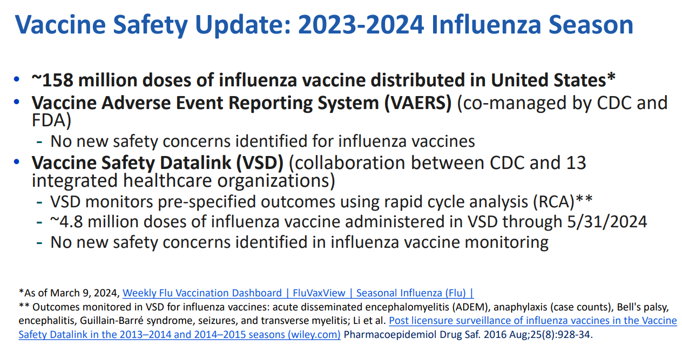
Influenza Vaccines
https://www.cdc.gov/vaccines/acip/meetings/slides-2024-06-26-28.html

Slide 16
H5N1 Bird Flu: Current Situation
H5N1 bird flu is widespread in wild birds worldwide and is causing outbreaks in poultry and U.S. dairy cows with three recent human cases in U.S. dairy workers.
While the current public health risk is low, CDC is watching the situation carefully and working with states to monitor people with animal exposures.
CDC is using its flu surveillance systems to monitor for H5N1 activity in people.
https://www.cdc.gov/bird-flu/situation-summary/index.html

Slide 17
Pneumococcal Vaccines
ACIP recommends PCV21 as an option for adults aged ≥19 years who currently have a recommendation to receive a dose of PCV.
https://www.cdc.gov/vaccines/acip/recommendations.html

Slide 18
Chikungunya Vaccines
Recommendations for use of chikungunya vaccine among travelers:
  ACIP recommends chikungunya vaccine for persons aged ≥18 years traveling to a country or territory where there is a chikungunya outbreak
  In addition, chikungunya vaccine may be considered for the following persons traveling to a country or territory without an outbreak but with evidence of chikungunya virus transmission among humans within the last 5 years
    Persons aged >65 years, particularly those with underlying medical conditions, who are likely to have at least moderate exposure* to mosquitoes, OR
    Persons staying for a cumulative period of 6 months or more
    *Moderate exposure could include travelers who might have at least 2 weeks (cumulative) of exposure to mosquitoes in indoor or outdoor settings.
https://www.cdc.gov/vaccines/acip/recommendations.html

Slide 19
Chikungunya Vaccines
Recommendations for use of chikungunya vaccine among laboratory workers:
  ACIP recommends chikungunya vaccine for laboratory workers with potential for exposure to chikungunya virus
https://www.cdc.gov/vaccines/acip/recommendations.html

Slide 20
For more information, contact CDC
1-800-CDC-INFO (232-4636)
TTY: 1-888-232-6348 cdc.gov
Follow us on X (Twitter) @CDCgov & @CDCEnvironment
The findings and conclusions in this report are those of the authors and do not necessarily represent the official position of the U. S. Centers for Disease Control and Prevention.

